Slide 1
NERDCORE
João Costa (x2)
Hugo Bugalho

Slide 2
TOPICS
What is Nerdcore?
Inspiration
Finally Coined!
We’re evolving…
Current state of the genre

Slide 3
WHAT IS NERDCORE?
Nerdcore is a genre of hip hop music characterized by subject matter considered of interest to nerds and geeks.

Slide 4
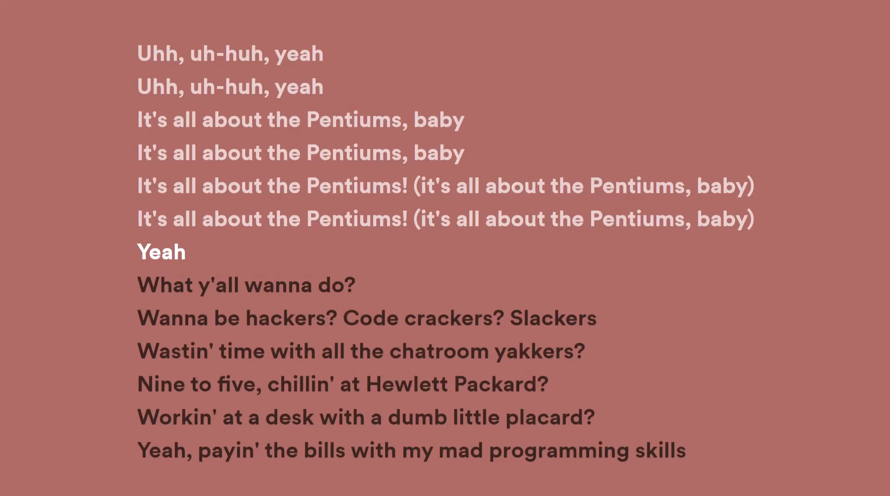
INSPIRATION
Bring on the “Weird Al”!

Slide 5
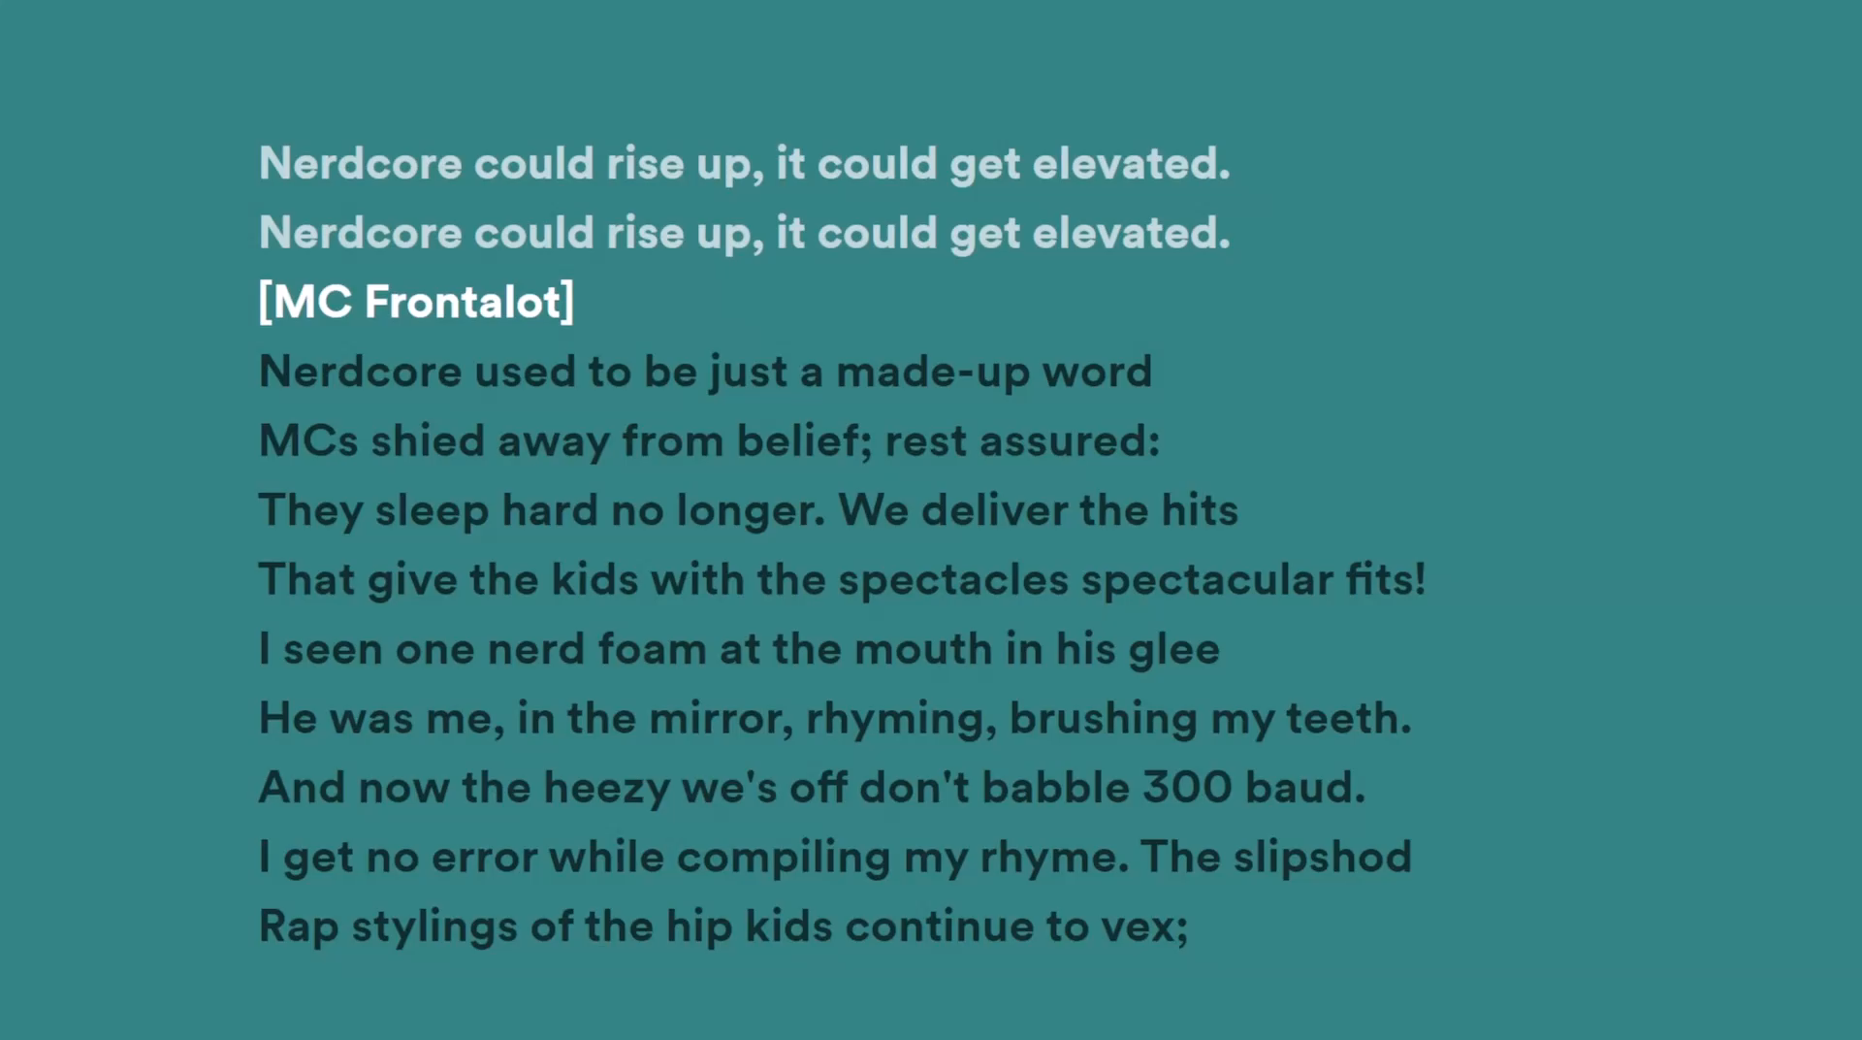
FINALLY COINED!
“Nerdcore could rise up”

Slide 6




GODFATHERS OF NERDCORE
MC FRONTALOT
YTCRACKER
DUAL CORE​
OHM-I​

Slide 7
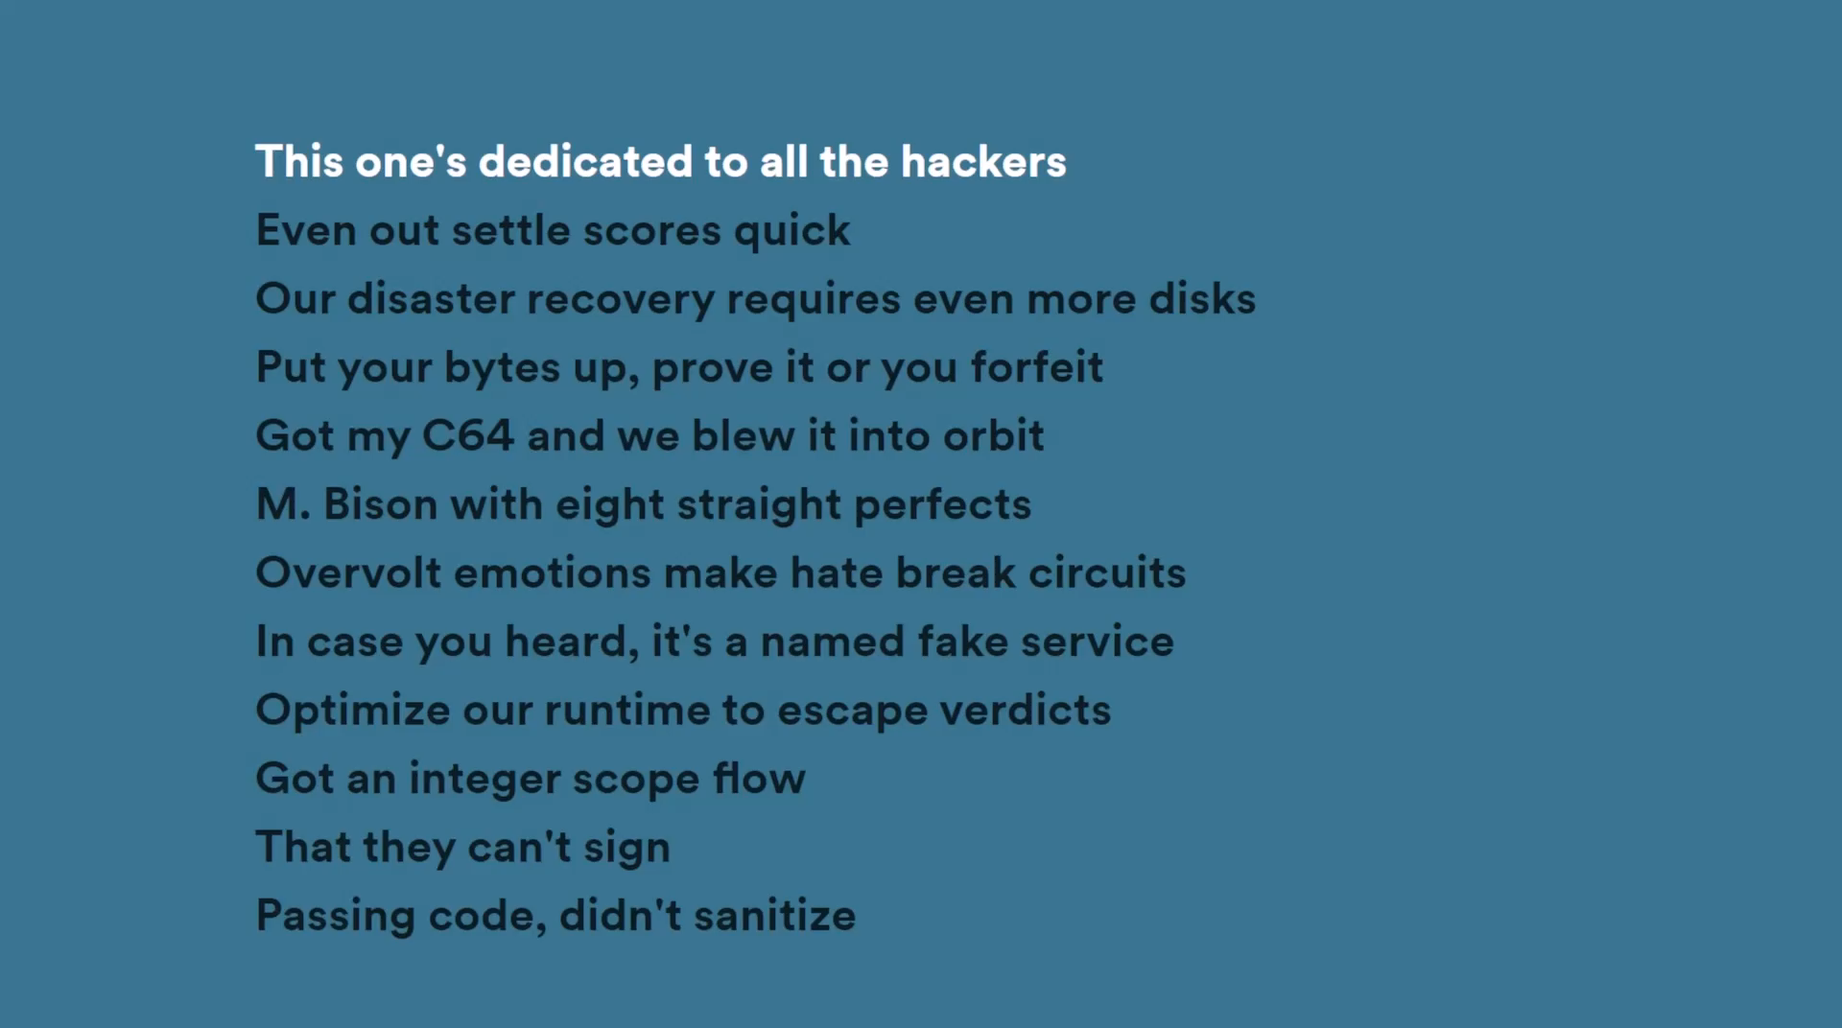
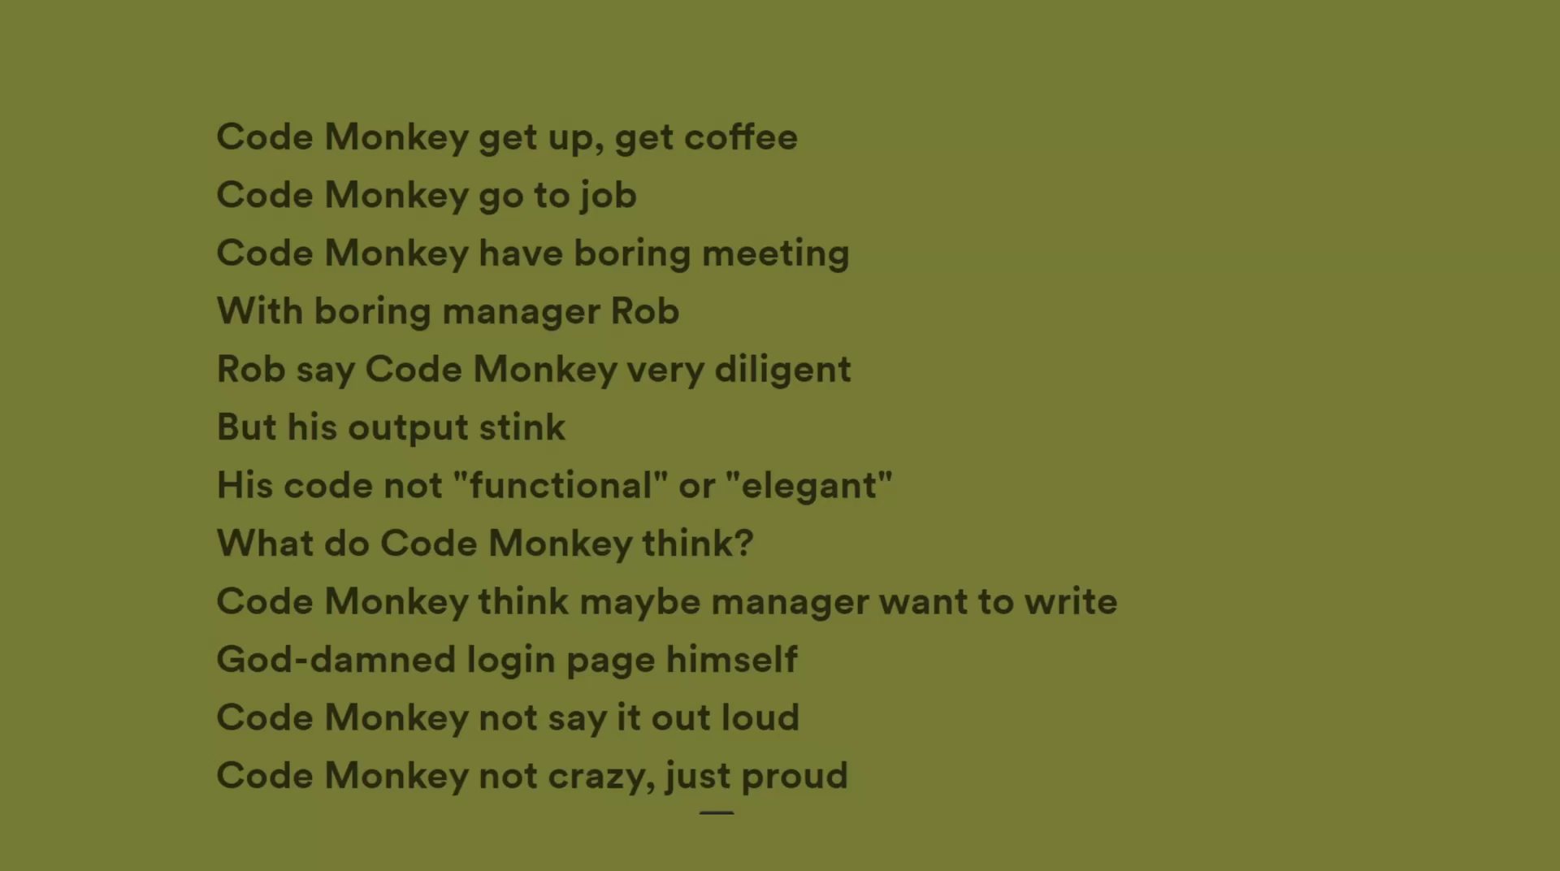
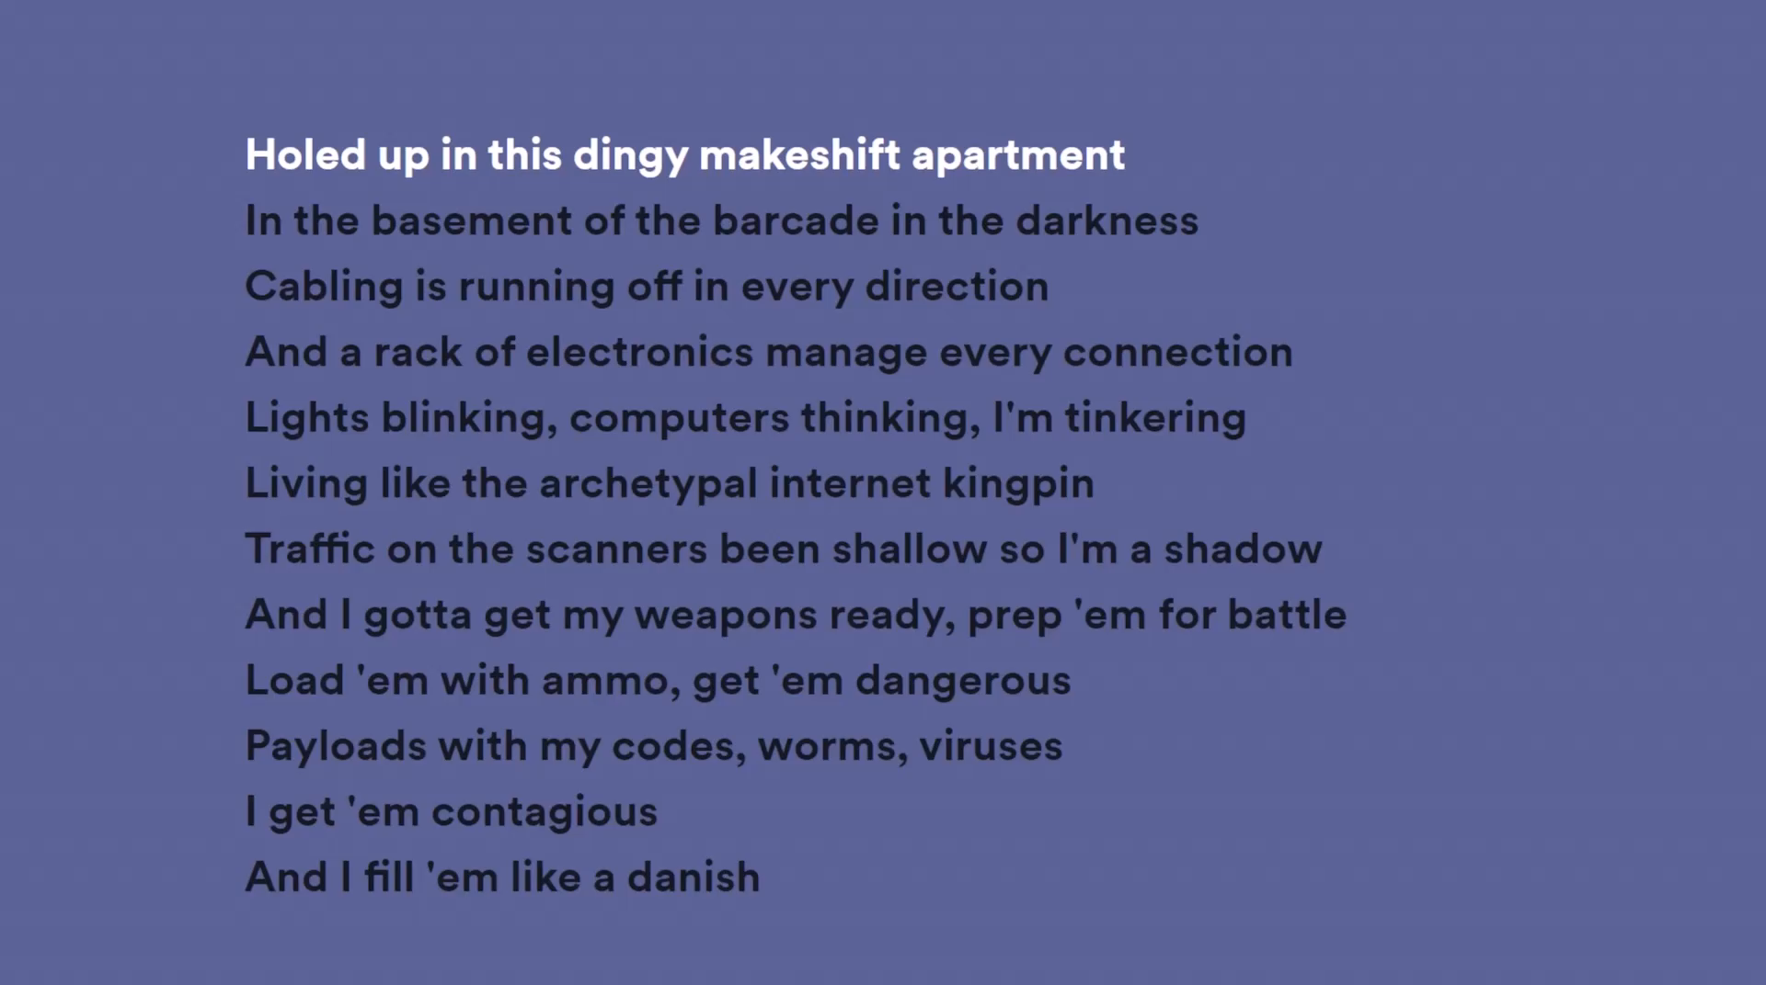
WE’RE EVOLVING…
1999
2005
2006
2012
2014
Weird Al
“It’s all about the Pentiums”
MC Frontalot
“Nerdcore Rising”
Jonathan Coulton
“Code Monkey”
Dual Core
“All the Things”
YTCracker
“System Failed”

Slide 8
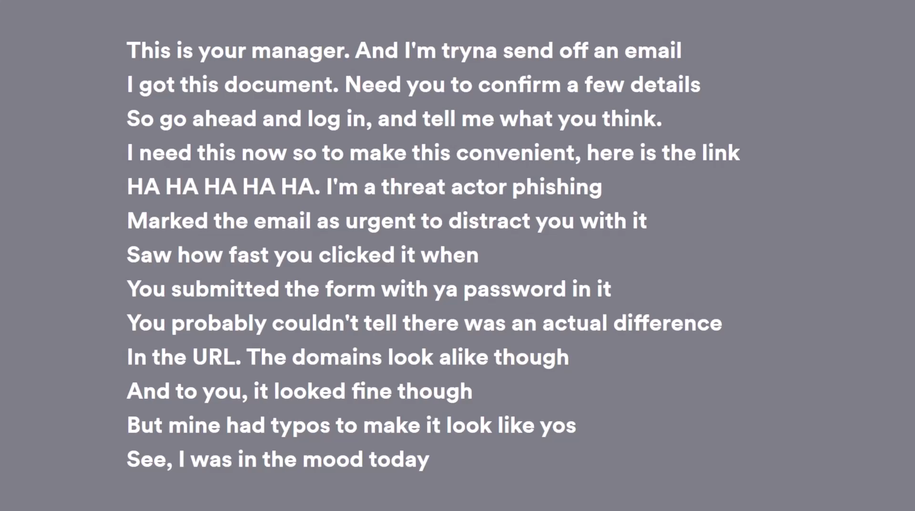
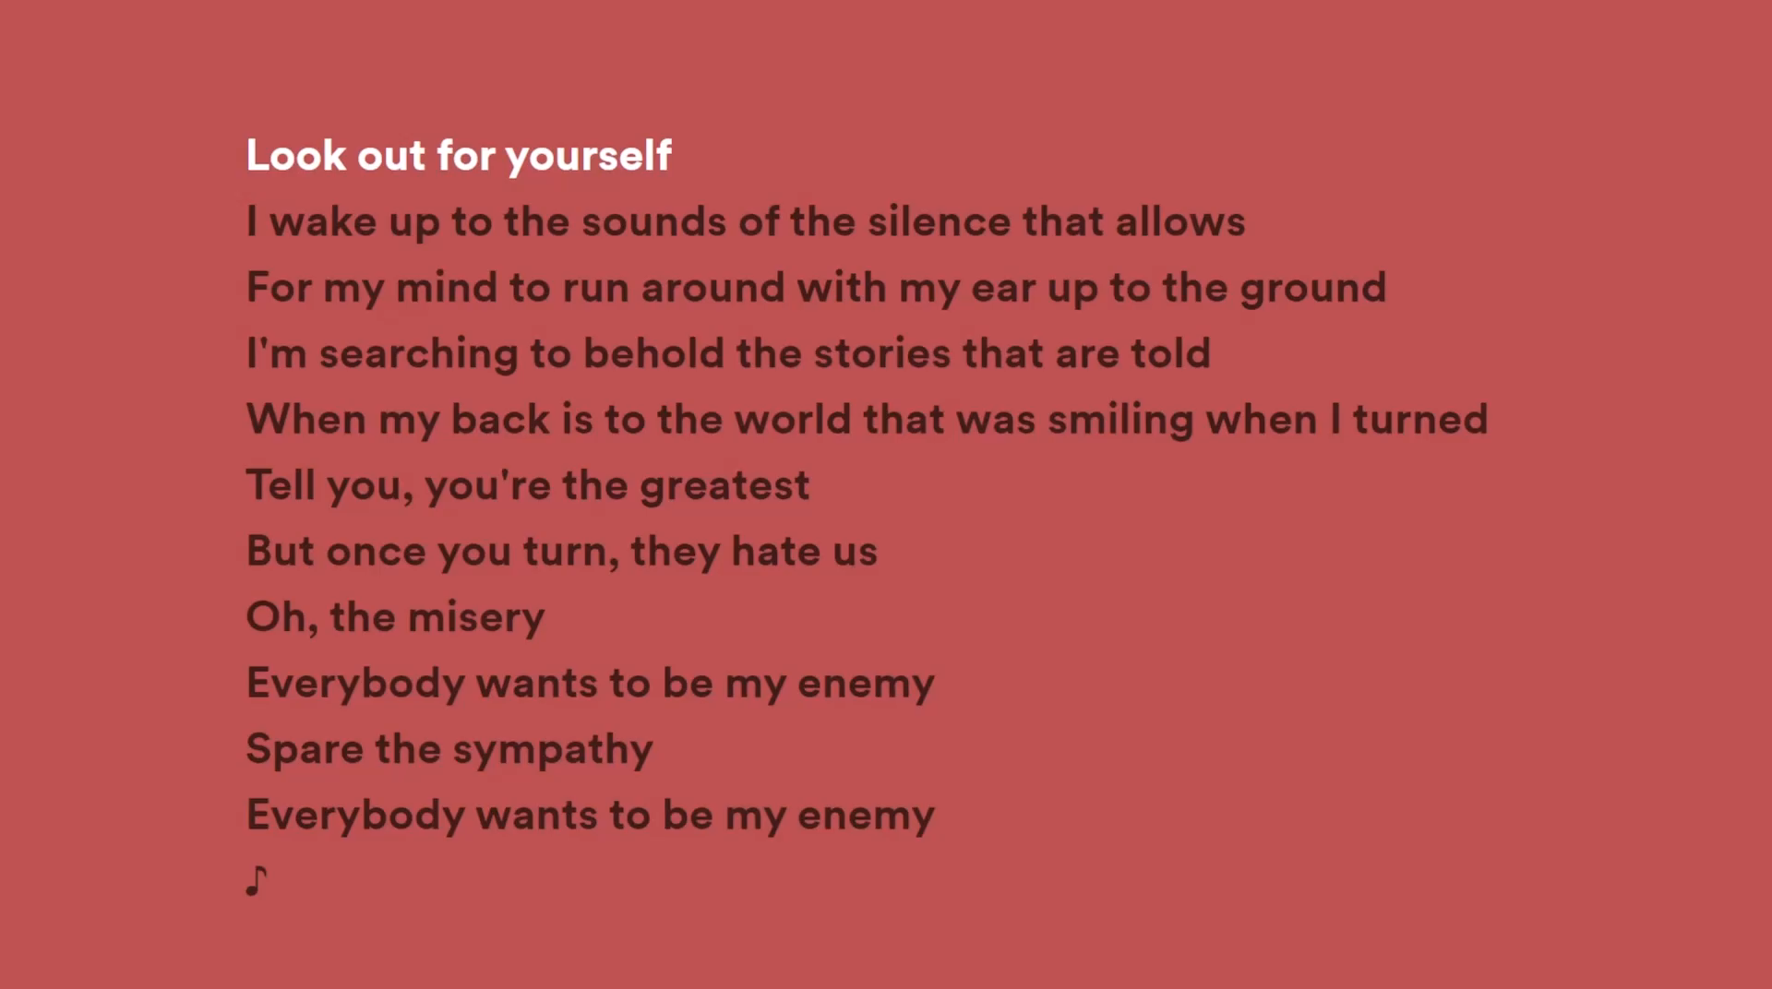

CURRENT STATE OF THE GENRE
THIS IS NERDCORE?!

Slide 9
FINAL Thoughts
Nerdcore do be slappin tho.

Slide 10
THANK YOU ☺

